Slide 1
Lightweight Restaurant Management System
Team: Bug Busters
Sushil Kukreja (203050020)
Ankit Raj (203050047)
Sumit Thorat (203050087)
Ramswaroop None (203050117)

Slide 2
Introduction
Lightweight Restaurant Management System is a software system which aims to digitise the order management process at restaurants whilst being very light, inexpensive and user friendly.
It does so by enabling the restaurant staff to make use of an Android app to view orders, edit menu, manage tables and view statistics.
It allows placing orders using a webapp which can be accessed via a table specific QR code.

Slide 3
Motivation
During this time of peril where Covid-19 is causing havoc, we are moving towards the new normal of masks and social distancing. One such place where there is high amount of exposure to the virus is a restaurant.
Everybody loves to eat outside once in a while but the risks attached with it are higher than normal.
This system would reduce the contact between various people to bare minimal by leveraging the power of technology. Being lightweight and inexpensive, even small scale restaurants can make use of this system to their advantage.

Slide 4
Problem Definition
Make a restaurant order management system which will allow the customer to scan a QR code on their mobile to view the menu and place orders.
Kitchen staff will use the application to view pending orders.
The restaurant management can make use of the application to view statistics such as average order completion time, most sold item, item sale quantity, current day’s total sale.
Restaurant management will also be able to manage the tables (add, delete and share the table specific QR code).

Slide 5
Timeline
Week | Target work
1 | Developing the backend i.e. learning how to expose an API in Python 3, set up the server.
2 | Add required functionalities in the server code. Implementing the interface to be exposed, connection with database and unit testing.
3 | Develop the client side applications. Design the UI and build the Android application.
4 | Connect client application with the server and test the entire system as a whole.

Slide 6
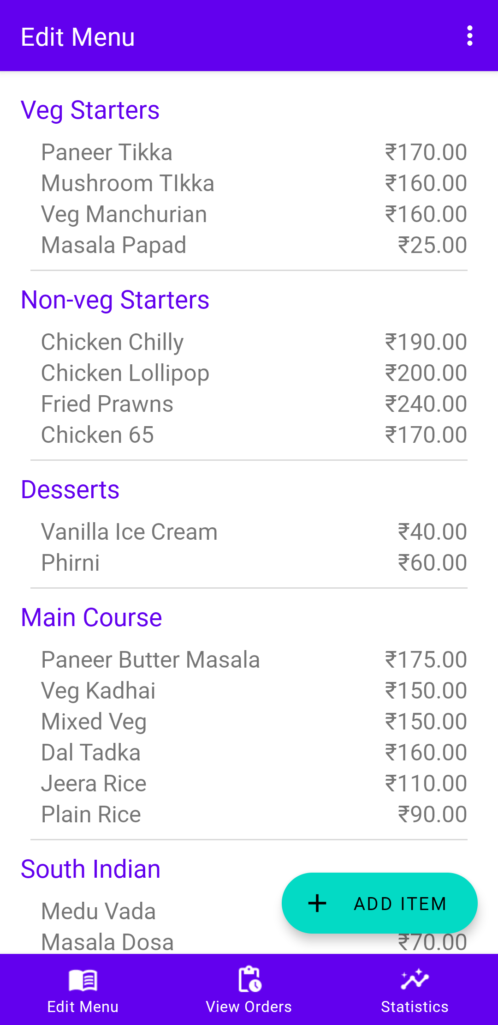
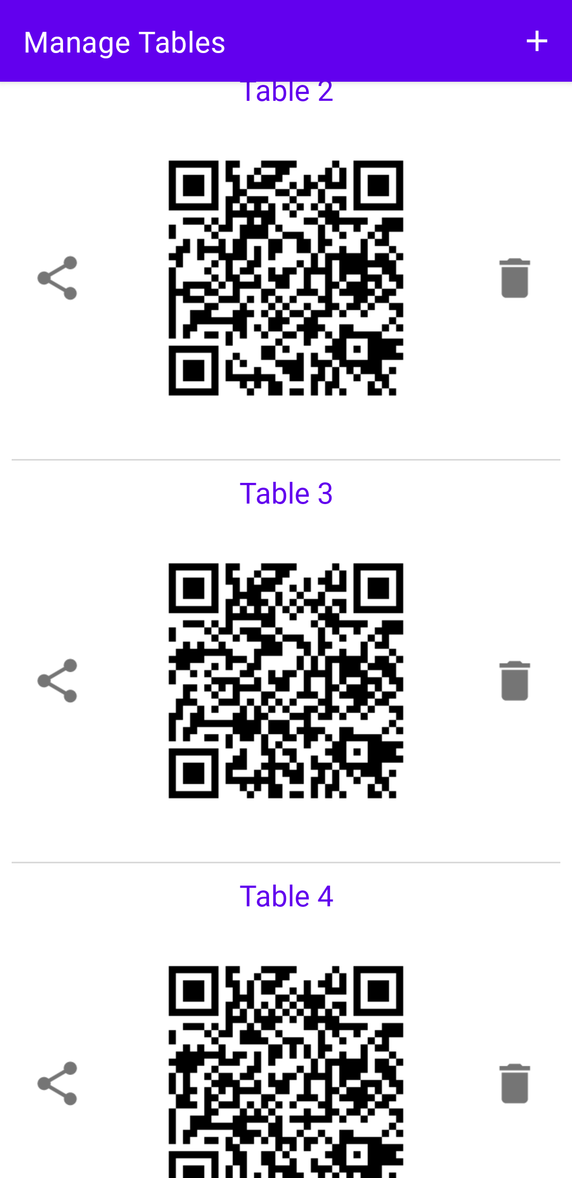
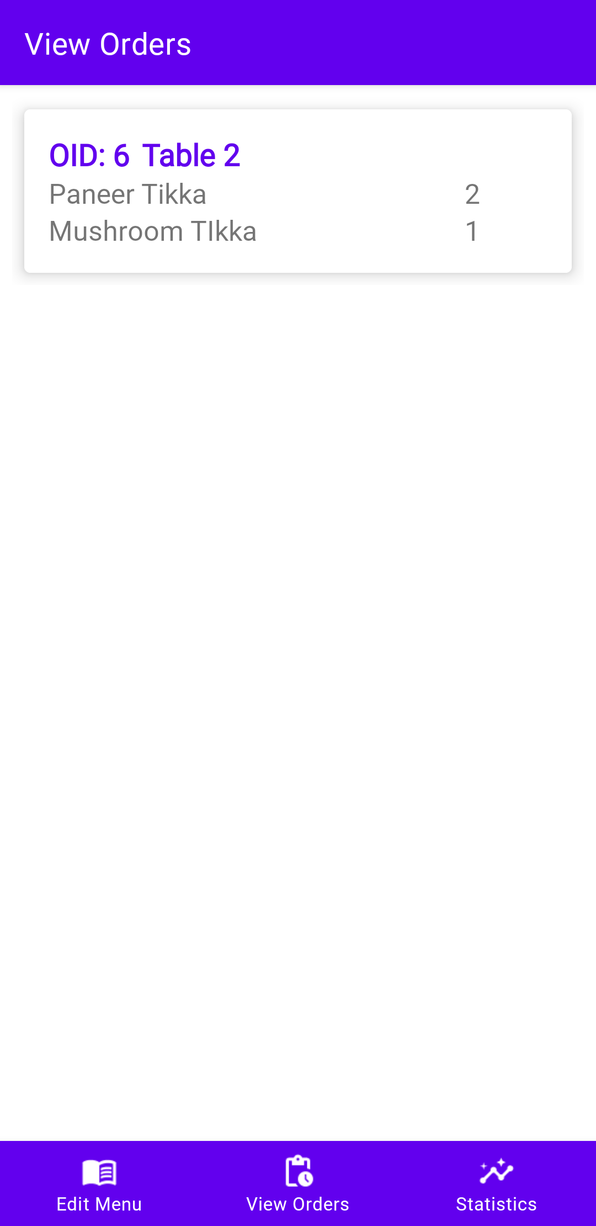
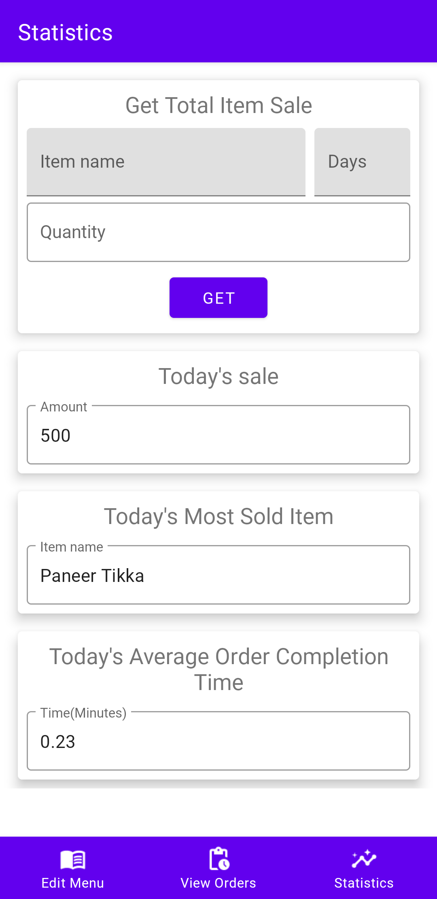
Snapshots (Android app)

Slide 7
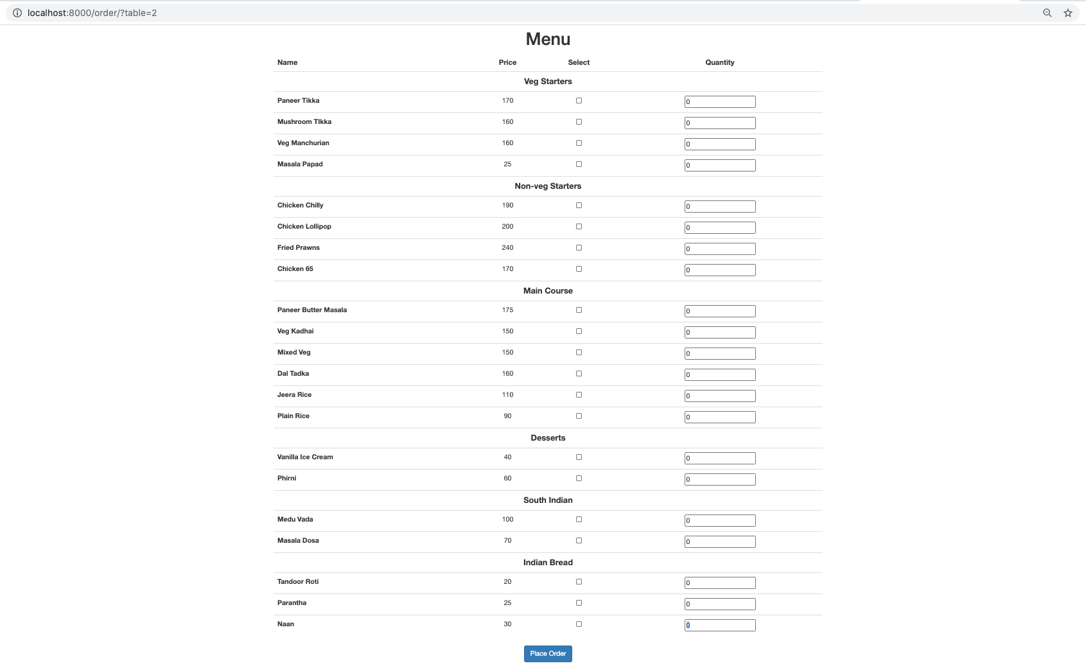
Snapshots (Webapp)

Slide 8
Work Distribution
Sushil Kukreja - Backend
Ankit Raj - Backend, Frontend
Sumit Thorat - Backend, Frontend
Ramswaroop -

Slide 9
References
https://stackoverflow.com/questions/46370836/android-movable-draggable-floating-action-button-fab
https://socket.io/blog/native-socket-io-and-android/
https://www.youtube.com/watch?v=USbTcGx1mD0&list=PLk7v1Z2rk4hjHrGKo9GqOtLs1e2bglHHA
https://www.material.io
https://www.youtube.com/watch?v=GMppyAPbLYk&ab_channel=TechWithTim
https://flask-sqlalchemy.palletsprojects.com/en/2.x/
https://www.woolseyworkshop.com/2020/06/25/documenting-python-programs-with-doxygen/
https://stackoverflow.com/questions/25594893/how-to-enable-cors-in-flask
https://docs.djangoproject.com/en/3.1/intro
https://developer.mozilla.org/en-US/docs/Learn/Server-side/Django/skeleton_website
https://github.com/mnooner256/pyqrcode/issues/39
https://stackabuse.com/encoding-and-decoding-base64-strings-in-python/

